Slide 1
Programmable Data Plane 可编程数据平面 Internet Architecture

Slide 2
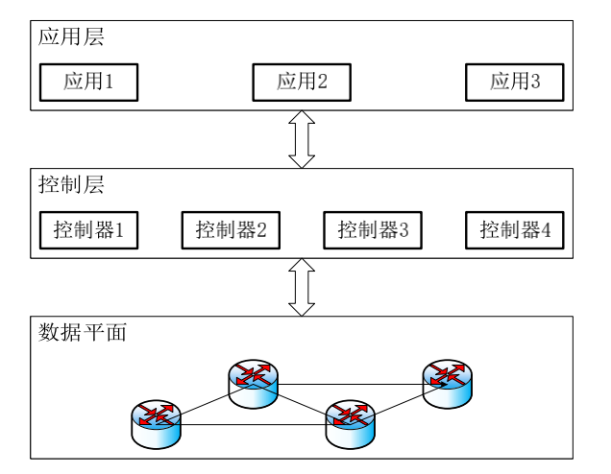
控制平面/数据平面
Control plane: Establishing routes for end-to-end connectivity, longer timescales of a few ms
路由软件，实现路径计算
Data plane: packet-to-packet behavior of a switch, short timescales of a few ns
可编程交换机等网络设备，实现数据包的处理功能

Slide 3
回顾SDN
With the introduction of the Software-defined Networking (SDN) paradigm, control plane has emerged as a separate entity, a logically centralized controller,
with some of the device control plane functions separated out and moved to this network-level functionality.
the individual switches do not need to implement the logic required to maintain packet forwarding policies locally (e.g., they do not run routing protocols to build routing tables);
rather, they get these policies prefabricated from the network control plane.
Here, the controller-switch communication occurs through a standardized southbound API, e.g. OpenFlow

Slide 4

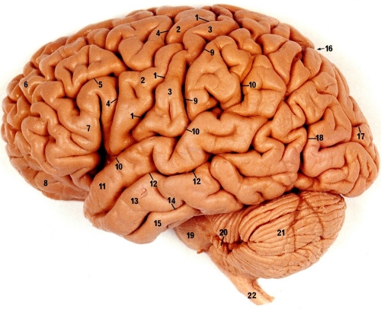
控制平面可编程
控制器
灵活添加新功能!
SDN主要关注控制平面/数据平面分离，在控制平面提供编程性
It distinguishes SDN from traditional networks
Source of many (perceived) challenges and opportunities
What about the data plane?
Which features should be provided in the data plane?
交换机
4

Slide 5
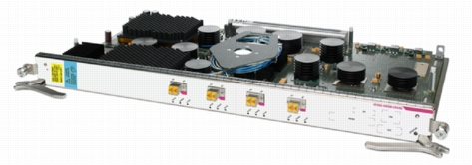
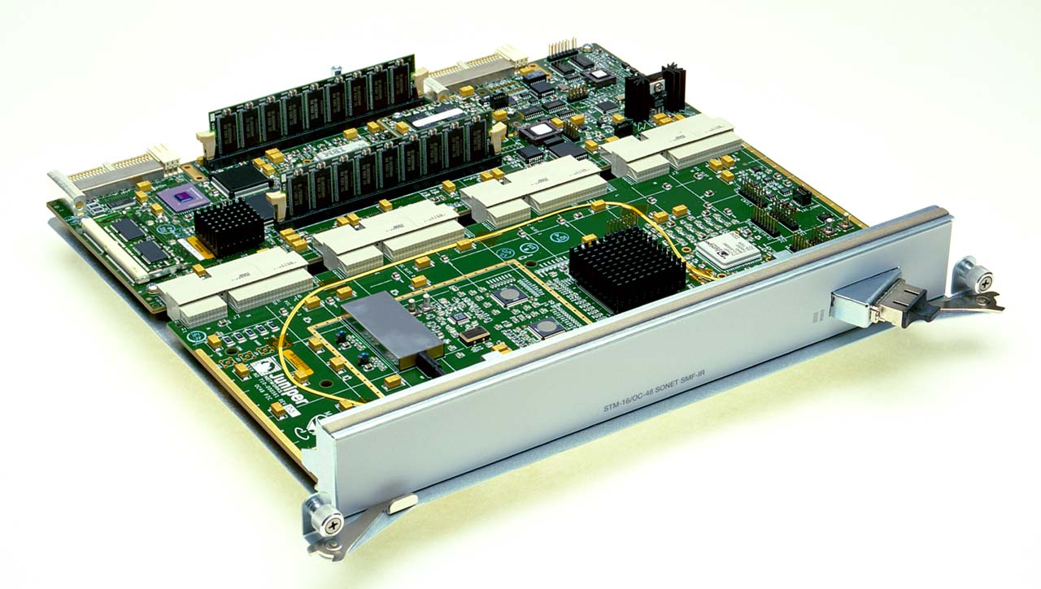
数据平面提供哪些功能？
基本功能 Streaming algorithms that act on packets
Matching on some bits, taking a simple action
… at behest of control and management plane
多样性
Forwarding
Access control
Mapping header fields
Traffic monitoring
Buffering and marking
Shaping and scheduling
Deep packet inspection

Slide 6
特点1: 高速 A Need for Speed
High link speed
10 Gbps, 40 Gbps, 100 Gbps
Small packets
40-byte TCP ACK packets
Small time per packet
40 Gbps =124 Mpps with 320-bit packets
8 ns to process a packet
Routers need low latency
Relatively limited opportunity to batch or pipeline

Slide 7
特点2: 异构 A Range of Technologies
ASIC (App-Specific Integrated Circuit)
Fast, dense chip, but expensive to change
FPGAs and network processors
Fast, reconfigurable, hard to program
Graphics Processing Units
Massive parallel computation on small cores
Software on commodity computer
Easy to program, but I/O bandwidth, memory copying, and interrupt overheads

Slide 8
Packet Forwarding

Slide 9
Packet Forwarding
Control plane computes a forwarding table
Maps destination address(es) to an output link
Handling an incoming packet
Match: destination address
Action: direct the packet to the chosen output link
Switching fabric
Directs packet from input link to output link
Processor
Switching
Fabric

Slide 10
Switch: Match on Destination MAC
MAC addresses are location independent
Assigned by the vendor of the interface card
Cannot be aggregated across hosts in the LAN
mac1
mac2
mac3
host
host
...
host
mac1
mac2
mac3
mac4
mac5
host
switch
mac5
Implemented using a hash table or a content addressable memory.
host
mac4

Slide 11
IP Routers: Match on IP Prefix
IP addresses grouped into common subnets
Allocated by ICANN, regional registries, ISPs, and within individual organizations
Variable-length prefix identified by a mask length
1.2.3.4
1.2.3.7
1.2.3.156
5.6.7.8
5.6.7.9
5.6.7.212
host
host
...
host
host
host
...
host
LAN 1
LAN 2
router
router
router
WAN
WAN
1.2.3.0/24
Prefixes may be nested. Routers identify the longest matching prefix.
5.6.7.0/24
forwarding table

Slide 12
Switch Fabric: From Input to Output
Data
1
1
Hdr
Header Processing
Queue
Packet
Lookup
Address
Update
Header
Address
Table
Buffer
Memory
Data
2
2
Hdr
Header Processing
Queue
Packet
Lookup
Address
Update
Header
Address
Table
Buffer
Memory
Data
Hdr
Header Processing
N
N
Queue
Packet
Lookup
Address
Update
Header
Address
Table
Buffer
Memory

Slide 13
Access Control

Slide 14
Access Control: Packet Filtering
“Five tuple” for access control lists (ACLs)
Source and destination IP addresses
TCP/UDP source and destination ports
Protocol (e.g., UDP vs. TCP)
Can be more sophisticated
E.g., block all TCP SYN packets from outside hosts
Should arriving packet be allowed in? Departing packet let out?

Slide 15
Applying Access Control Lists
Ordered list of “accept/deny” clauses
A clause can have wild cards
Clauses can overlap
… so order matters
Packet classification
Given all of the fields
… identify the match with the highest priority
Two approaches
Clever algorithms for multi-dimensional classification
Ternary Content Addressable Memories (TCAMs)
Src=1.2.3.4, Dest=5.6.7.8 | Deny
Dest=1.2.3.* | Allow
Dest=1.2.3.8, Dport!=53 | Deny
Src=1.2.3.7, Dport=100 | Allow
Dport=100 | Deny

Slide 16
Mapping Header Fields

Slide 17
Network Address Translation (NAT)
138.76.29.7
10.0.0.1
outside
NAT
inside
10.0.0.2

Slide 18
Mapping Addresses and Ports
Remap IP addresses and TCP/UDP port numbers
Addresses: between end-host and NAT addresses
Port numbers: to ensure each connection is unique
Create table entries as packets arrive
Src 10.0.0.1, Sport 1024, Dest 1.2.3.4, Dport 80
Map to Src 138.76.29.7, Sport 1024, Dest 1.2.3.4, Dport 80
Src 10.0.0.2, Sport 1024, Dest 1.2.3.4, Dport 80
Map to Src 138.76.29.7, Sport 1025, Dest 1.2.3.4, Dport 80
Challenges
When to remove the entries
Running services behind a NAT
What if both ends of a connection are behind NATs

Slide 19
Traffic Monitoring

Slide 20
Observing Traffic Passing Through
source
dest
input
output
source
prefix
dest
prefix
source AS
intermediate AS
dest AS
Applications of traffic measurement
Usage-based billing
Network engineering
Detecting anomalous traffic

Slide 21
Passive Traffic Monitoring
Counting the traffic
Match based on fields in the packet header
… and update a counter of #bytes and #packets
Examples
Link
IP prefixes
TCP/UDP ports
Individual “flows”
Challenges
Identify traffic aggregates in advance vs. reactively
Summarizing other information (e.g., time, TCP flags)
Not knowing if you see all packets in a connection
Dest Prefix | #Packets | #Bytes
1.2.3.0/24 | 3 | 1500
7.8.0.0/16 | 10 | 13000
8.0.0.0/8 | 100 | 85020
7.7.6.0/23 | 1 | 40

Slide 22
More on the motivation for Traffic Monitoring
Needs of Service Providers
Understand the behavior of their networks
Provide fast, high-quality, reliable service to satisfy customers and thus reduce churn rate
Plan for network deployment and expansion
SLA monitoring, Network security
Increase Revenue!
Usage-based billing for network users (like telephone calls)
Marketing using CRM data
Needs of Customers
Want to get their money’s worth
Fast, reliable, high-quality, secure, virus-free Internet access
To Satisfy Service Providers’ Needs to Satisfy Their Customers!

Slide 23
Motivation (2/2)
Application Areas
Network Problem Determination and Analysis
Traffic Report Generation
Intrusion & Hacking Attack (e.g., DoS, DDoS) Detection
Service Level Monitoring (SLM)
Network Planning
Usage-based Billing
Customer Relationship Management (CRM)
Marketing

Slide 24
Problems
Capturing Packets
High-speed networks (Mbps → Gbps → Tbps)
High-volume traffic
Streaming media (Windows Media, Real Media, Quicktime)
P2P traffic
Network Security Attacks
Flow Generation & Storage
What packet information to save to perform various analysis?
How to minimize storage requirements?
Analysis
How to analyze and generate data needed quickly?
What kinds of info needs to be generated? → Depends on applications

Slide 25
Research & Development Goals
Develop Methods to
Capture all packets
Generate flows
Store flows efficiently
Analyze data efficiently
Generate various reports or information that are suitable for various application areas
Develop a Flexible, Scalable Traffic Monitoring and Analysis System for
High-speed
High-volume
Rich media IP networks

Slide 26
Network Monitoring Metrics (1/5)
Connectivity
Availability
Functionality
One way loss
Loss
RT loss
Network Monitoring
Metrics
One way delay
Delay
RT delay
Delay variance
Capacity
Utilization
Bandwidth
Throughput

Slide 27
Network Monitoring Metrics (2/5)
Availability
The percentage of a specified time interval during which the system was available for normal use
What is supposed to be available?
Service, Host, Network
Availabilities are usually reported as a single monthly figure
99.99% availability means that the service is unavailable for 4 minutes during a month
One can test availability by sending suitable packets and observing the answering packets (latency, packet loss)
Metrics
Connectivity: the physical connectivity of network elements
Functionality: whether the associated system works well or not

Slide 28
Network Monitoring Metrics (3/5)
Packet Loss
The fraction of packets lost in transit from a host to another during a specified time interval
Internet packet transport works on a best-effort basis, i.e., a router may drop them depending on its current conditions
A moderate level of packet loss is not in itself tolerable
Some real-time services, e.g., VoIP, can tolerate some packet losses
TCP resends lost packets at a slower rate
Metrics
One way loss
Round Trip (RT) loss

Slide 29
Network Monitoring Metrics (4/5)
Delay (Latency)
The time taken for a packet to travel from a host to another
Round Trip Time (RTT)
Forward transport delay + server delay + backward transport delay
Forward transport delay is often not the same as backward transport delay (may use different paths)
For streaming applications, high delay or delay variation (jitter) can cause degradation on user-perceived QoS
Metrics
One way delay
Round Trip Time (delay)
Delay variance (jitter)

Slide 30
Network Monitoring Metrics (5/5)
Throughput
The rate at which data is sent through the network, usually expressed in bytes/sec, packets/sec, or flows/sec
Be careful in choosing the interval; a long interval will average out short-term bursts in the data rate
A good compromise is to use one- to five-minute intervals, and to produce daily, weekly, monthly, and yearly plots
Link Utilization over a specified interval is simply the throughput for the link expressed as a percentage of the access rate
Metrics
Link Capacity (Mbps, Gbps)
Throughput (bytes/sec, packets/sec, flows/sec)
Utilization (%)

Slide 31

Traffic Monitoring Approaches (1/4)
Passive Monitoring
Active Monitoring

Slide 32
Traffic Monitoring Approaches (2/4)
Active Monitoring
Performed by sending test (probe) traffic into network
Generate test packets periodically or on-demand
Measure performance of test packets or responses
Take the statistics
Impose extra traffic on network and distort its behavior in the process
Test packet can be blocked by firewall or processed at low priority by routers
Mainly used to monitor network performance
Test packet
generator
Test packet
probe
Response
Probe
Target
host

Slide 33
Traffic Monitoring Approaches (3/4)
Passive Monitoring
Carried out by observing network traffic
Collect packets from a link or network flow from a router
Perform analysis on captured packets for various purposes
Network device performance degrades by mirroring or flow export
Used to perform various traffic usage/characterization analysis or intrusion detection
Network link
Packet
Capture
Traffic
Analysis
Traffic
Information
Router
Flow
Generation
Flow
Data

Slide 34
Traffic Monitoring Approaches (3/4)
Comparison of Two Monitoring Approaches
 | Active Monitoring | Passive Monitoring
Configuration | Multi-point | Single or multi-point
Data size | Small | Large
Network overhead | Additional traffic | Device overhead No overhead if splitter is used
Purpose | Delay, packet loss, availability | Throughput, traffic pattern, trend, & detection
CPU Requirement | Low to Moderate | High
Advantages | Gain some benefits at the initial stage of network construction, because not much data gained from passive one | Measured result may show the real network characteristics Does not need to generate additional probe messages
Disadvantages | Cannot reflect network characteristics Need to generate the probe messages which may cause extra overhead to network | Captured data has massive volume size Should have additional facility to capture the mirrored packet from network

Slide 35
Active Monitoring Techniques
ICMP-based Method
Diagnose network problems
Availability / Round-trip delay / Round-trip packet loss
TCP-based Method
One-way bandwidth / Round trip bandwidth
Bulk transfer rate
UDP-based Method
One-way packet loss / Round trip bandwidth

Slide 36
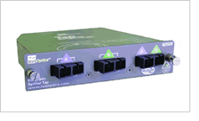
Passive Monitoring Techniques
Packet Capturing
Packets can be captured using Port Mirroring or Network Splitter (Tap)
Probe system
Probe system
Mirroring
Splitting
 | Port Mirroring | Network Splitter
How it works | - Copies all packets passing on a port to another port | - Splits the signal and sends a signal to original path and another to probe
Advantage | - No extra hardware required | - No processing overhead on router/switch
Disadvantage | - Processing overhead on router/switch | - Splitter hardware required

Slide 37
Packet Capturing (2/2)
Difficulties in packet capturing
Massive amount of data
How much packet data is generated from 100 Mbps network in an hour?
→ Port speed ⅹIn&Out ⅹLink Utilization ⅹ sec/hour = throughput
100 Mbps ⅹ 2 ⅹ 0.5 ⅹ 3600 = 360 Gbps
→ Throughput / avg. packet lengthⅹ bytes of packet data = data size
360 Gbps / (1500 ⅹ 8) ⅹ 30 = 1 Gbyte
Processing of high-speed packets
Processing time for 100 Mbps network
Port speed ⅹ In&Out ⅹ Link Utilization / average packet length
= 8333 packets/sec => 0.12 msec/packet
 | 100 Mbps | 1 Gbps | 1 Tbps
Data size per hour (assume 0.5 link util) | 1 Gbyte | 10 Gbyte | 10 Tbyte
Processing Time per packet | 0.12 msec | 0.012 msec | 0.012 μsec

Slide 38
Sampling
Why We Need Sampling?
If the rate is too high to capture all packets reliably, there is no alternative but to sample the packets
Sampling algorithms: every Nth packet or fixed time interval
1 2 3 4 5 6 7 8 9 10 11
(a) 2:1 sampling
0 msec
1 msec
2 msec
3 msec
4 msec
(b) 1 msec sampling

Slide 39
Flow Generation
Flow
Flow is a collection of packets with the same {SRC and DST IP address, SRC and DST port number, protocol number}
Flow data can be collected from routers directly, or standalone flow generator having packet capturing capability
Popular flow formats
NetFlow (Cisco), sFlow (sFlow.org), IPFIX (IETF)
Issues in flow generation
What information should be included in a flow data?
How to generate flow data from raw packet information efficiently?
How to save bulk flow data into DB or binary file in a collector?
How long should the data be preserved?
flow 1
flow 2
flow 3
flow 4

Slide 40
Traffic Analysis Aspects
Spatial Aspect
The patterns of traffic flow relative to the network topology
Important for proper network design and planning
Identification of bottleneck & avoidance of congestion
Example: Flow aggregation by src, dst IP address or AS number
Temporal Aspect
The stochastic behavior of a traffic flow, described in statistical terms
Important for resource management and traffic control
Important for traffic shaping and caching policies
Example: Packet or byte per hour, day, week, month
Composition of Traffic
A breakdown of traffic according to the contents, application, packet length, flow duration
Helps to explain its temporal and spatial characteristics
Example: game, streaming media traffic for a week from peer ISP

Slide 41
Traffic Classification/Identification (1/2)
Traffic Classification
Classifying traffic based on features passively observed in the traffic, and according to specific classification goals
Types of Traffic Classification
Port-based approaches
E.g., TCP port 20 and 21 → FTP, TCP port 80 → HTTP
Payload-based approaches
E.g., “0x12BitTorrent protocol” → BitTorrent
Machine Learning (ML)-based approaches
Connection-related statistical information-including connection duration, inter-packet arrival time, and packet
 | Accuracy | Strength | Weakness
Port-based | Low | Low computational cost | Low accuracy
Payload-based | High | Most accurate method | High computational cost Exhaustive signature generation
ML-based | High | Can handle encrypted traffic | High computational cost

Slide 42
Traffic Classification/Identification (2/2)
In the Perspective of Network Layers
Network Layer
IP, ARP, RARP, etc.
Transport Layer
TCP, UDP, ICMP, etc.
Application Layer
HTTP, HTTPS, SMTP, FTP, TELNET, SSH, POP, etc.
Classification Level in Practice (Classification Output)
Traffic clustering
Bulk transfer, small transaction, etc.
Application-type breakdown
Web, game, P2P, messenger, streaming, mail, etc.
Application protocol breakdown
HTTP, HTTPS, SMTP, FTP, TELNET, SSH, POP, etc.
Application Breakdown
BitTorrent, MSN, NateOn, Filezilla FTP, etc.

Slide 43
Resource Allocation: Buffering, Scheduling, Shaping, and Marking

Slide 44
Buffering
Drop-tail FIFO queue
Packets served in the order they arrive
… and dropped if queue is full
Random Early Detection (RED)
When the buffer is nearly full
… drop or mark some packets to signal congestion
Multiple classes of traffic
Separate FIFO queue for each flow or traffic class
… with a link scheduler to arbitrate between them

Slide 45
Link Scheduling
Strict priority
Assign an explicit rank to the queues
… and serve the highest-priority backlogged queue
Weighted fair scheduling
Interleave packets from different queues
…in proportion to weights
50% red, 25% blue, 25% green

Slide 46
Traffic Shaping
Force traffic to conform with a profile
To avoid congesting downstream resources
To enforce a contract with the customer
Leaky-bucket shaping
Can send at rate r and intermittently burst
Parameters: token rate r and bucket depth d
Tokens arrive (rate r)
Max # of tokens
(d tokens)
tokens
A leaky-bucket shaper for each flow or traffic class
packets

Slide 47
Traffic Classification and Marking
Mark a packet to influence handling downstream
Early Congestion Notification (ECN) flag
Type-of-Service (ToS) bits
Ways to set the ToS bits
End host sets the bits based on the application
But, then the network must trust (or bill!) the end host
Network sets the bits based on traffic classes
But, then the network needs to know how to classify packets
Identifying traffic classes
Packet classification based on the “five tuple”
Rate limits, with separate mark for “out of profile” traffic

Slide 48
Generalizing the Data Plane

Slide 49
Data Plane Functions Summary
Basic functional steps:
parsing, classification, modification, deparsing, and forwarding.
Additional services, such as
scheduling, filtering, metering, or traffic shaping.
实现方式
通常都是专用的设备

Slide 50
传统网络设备
Traditional networking devices such as routers and switches process packets using data and control plane algorithms.
However, conventional network equipment the data plane functionality is deeply ingrained into the device hardware and software, and hence generally cannot be changed during the lifetime of the device.
Users can configure control plane features and protocols, e.g., via CLIs, web interfaces, or management APIs, but the underlying algorithms can be changed only by the vendor.

Slide 51
Data Plane Tension
Mordern networks are deployed in different environments, support a variety of use cases, and are subject to requirements ranging from best effort to guaranteed performance.
This wide-spread use and heterogeneity complicate the design of network systems and their main building blocks (devices).
Tension
Specialization: allows network devices to be optimized for a particular task
Generality: make network devices commodity and general to reduce engineering cost.

Slide 52
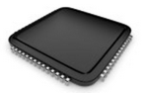
传统网络设备
Feature
Feature
Software
Team
Network Owner
Network Equipment Vendor
Weeks
Feature
Years
ASIC
Team
Years
Equipment vendor can’t just send you a software upgrade
New forwarding features take years to develop
By then, you’ve figured out a kludge to work around it
Your network gets more complicated

Slide 53
Need for Programmability
These opposite forces ultimately pushed the need (and definition) of programmable networking equipment, allowing operators to change device functionality using a programming interface.
Programmability introduces a significant change in the relationship between device vendors and network operators.

Slide 54
为什么要实现可编程性
用户角度：A programmable device frees the operator from waiting for the traditional networking equipment’s years-long release cycles
new feature can be quickly implemented and rolled out directly by the operator using programming interface
设备商角度：Programmability also frees device vendors from designing equipment for a wide range of customer use cases;
instead, they can invest engineering efforts into optimizing a set of well-defined building blocks that can be used to implement custom logic.

Slide 55
现有设备种类众多，但有相似性
Router
Forward on destination IP address
Access control on the “five tuple”
Link scheduling and marking
Monitoring traffic
Deep packet inspection
Switch
Forward on destination MAC address
Firewall
Access control on “five tuple” (and more)
NAT
Mapping addresses and port numbers
Shaper
Classify packets
Shape or schedule
Packet sniffer
Monitoring traffic

Slide 56
抽象
网络技术发展离不开抽象
IP是对多种底层连接技术的抽象
TCP是对端到端可靠性的抽象
多种数据平面设备都被抽象为统一的match-action设备
匹配：包头对应字段
操作：实现对数据包的丢包、修改、缓存等操作

Slide 57
用match-action抽象来统一各种设备
Router
Match: longest destination IP prefix
Action: forward out a link
Switch
Match: destination MAC address
Action: forward or flood
Firewall
Match: IP addresses and TCP/UDP port numbers
Action: permit or deny
NAT
Match: IP address and port
Action: rewrite address and port

Slide 58
OpenFlow
数据平面提供match-action
Match
Match on a subset of bits in the packet header
E.g., key header fields (addresses, port numbers, etc.)
Well-suited to capitalize on TCAM hardware
Action
Perform a simple action on the matching packet
E.g., forward, flood, drop, rewrite, count, etc.
控制平面集中控制数据平面 Controller
Software that installs rules and reads counts
... and handles packets the switch cannot handle

Slide 59
Match-Action Abstraction
OpenFlow has become quite well-known as an interface between the control plane and the forwarding plane
“Match-Action” is the key:
Roughly, a subset of packet bytes are matched against a table; the matched entry specifies a corresponding action(s) that are applied to the packet.
Priority | Predicate | Action
5 | dst_ip = H1 | Fwd 1
5 | dst_ip = H2 | Fwd 2

Slide 60

Data-Plane: Simple Packet Handling
Simple packet-handling rules
Pattern: match packet header bits
Actions: drop, forward, modify, send to controller
Priority: disambiguate overlapping patterns
Counters: #bytes and #packets
src=1.2.*.*, dest=3.4.5.* → drop
src = *.*.*.*, dest=3.4.*.* → forward(2)
3. src=10.1.2.3, dest=*.*.*.* → send to controller

Slide 61
Control/Data Separation
SDN makes network devices programmable by introducing an API that allows users to bypass the built-in control plane algorithms and to replace them with self-defined algorithms.
Those algorithms are expressed in software and typically run on an SDN controller with an overall view of the network.
Thereby, complex control plane algorithms designed for distributed control can be replaced by simpler algorithms designed for centralized control.

Slide 62
SDN可编程
Move control plane out of the switch onto a server.
Well-defined API to data plane (OpenFlow)
Match on fixed headers, carry out fixed actions.
Which headers: Lowest common denominator (TCP, UDP, IP, etc.)
Write your own control program.
Traffic Engineering
Access Control Policies
Thus, SDN makes control plane programmable.
Notes:
Remind them that OpenFlow is based on match + action.
But it is restricted to a specific set of headers, and nothing more.

Slide 63
Data Plane Programmability
With SDN, Device functionality has become much more flexible and dynamic.
However, OpenFlow is not enough
allow packet processing on a fixed set of fields only
OpenFlow assumed a specific data plane functionality
It executed the sole, although relatively flexible, algorithm defined by the OF specifications.
fixed function data plane can not be changed.

Slide 64
OpenFlow不能真正软件定义
OpenFlow最早将数据平面的转发逻辑和控制平面的控制逻辑解耦 合，OpenFlow 协议中事先定义协议字段，控制平面按照已有的协议对数据平面进行控制。如果需要增加新的功能就需要对 Openflow 协议进行扩展。
因此 OpenFlow本质上是协议相关的，并非真正的完全“软件定义”
但是，在固定功能数据平面仍然在广泛应用的情况下，OpenFlow 为向 SDN 的平滑过渡提供了支持

Slide 65
The solution: a programmable switch
data plane programmability means that the data plane with its algorithms can be defined by the users
Change switch however you like.
Each user ”programs” their own algorithm.
Much like we program desktops, smartphones, etc.
Notes:
Pause for question: Why might you ever want to change your network’s switches?

Slide 66
Programmable data planes
Programmable data planes enable users to implement their own data plane algorithms on forwarding devices.
Users, e.g., programmers, practitioners, or operators, may define new protocol headers and forwarding behavior, which is without programmable data planes only possible for a vendor.

Slide 67
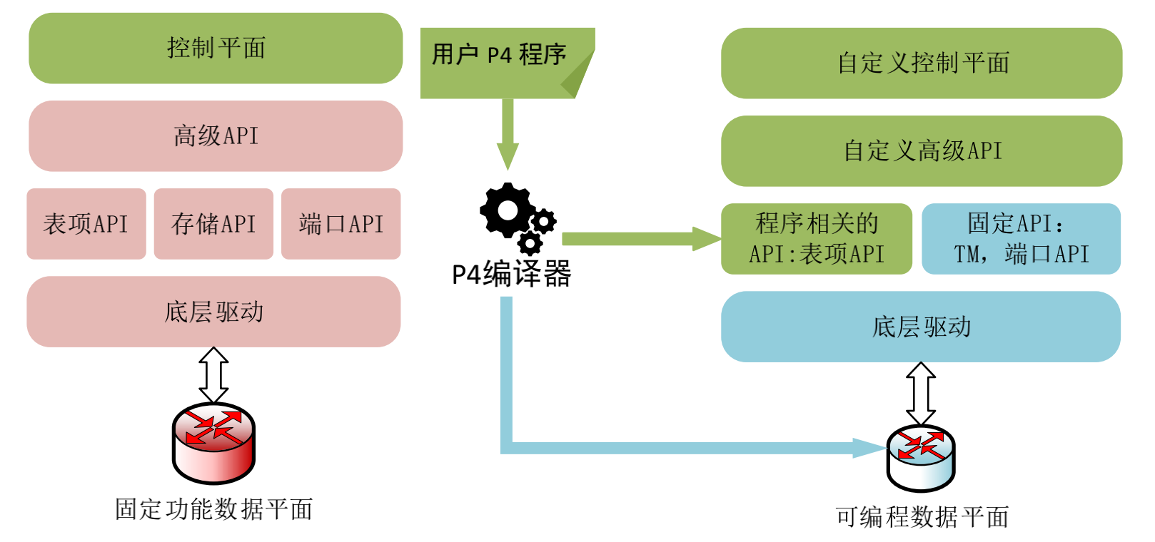
可编程数据平面
完全可编程的数据平面通常是协议无关的，提供了更加灵活的功能

Slide 68
Is Software Router Possible?
Of course, we can implement Match-Action in software on a general purpose CPU.
But for the speeds we are interested in dedicated hardware.

Slide 69
Early attempts at programmable routers
10—100 x loss in performance relative to line-rate, fixed-function routers
Unpredictable performance (e.g., cache contention)
Notes:
How would _you_ design a programmable router?
Mention that it is on log scale
Define line rate
Unpredictable performance examples: hardware config (number of cores, RAM size, etc.)

Slide 70
The RMT model: programmability + performance
Reconfigurable match tables, such as RMT , allow the programmer to match on and modify all header fields (or arbitrary bit ranges) making the devices significantly more flexible and capable.
Performance: 640 Gbit/s (also called line rate), now 6.4 Tbit/s.
Programmability: New headers, new modifications to packet headers, flexibly size lookup tables, (limited) state modification
Notes:
What is match-action?
Why use a pipeline?

Slide 71
RMT: Two simple ideas
Programmable parser
Pipeline of match-action tables
Match on any parsed field
Actions combine packet-editing operations (pkt.f1 = pkt.f2 op pkt.f3) in parallel
Notes:
This is all you really need to know about the paper ☺
The rest is just how to make it run at 1 GHz
The idea that you can take different logical tables and split them across pipelines in a flexible way.

Slide 72
Programmable parser (Gibb et al. ANCS 2013)
State machine + field extraction in each state (Ethernet, IP, etc.)
State machine implemented as a TCAM
Configure TCAM based on parse graph
Notes:
Say that it’s not very different from how grep works on Linux.

Slide 73
Match/Action Forwarding Model
Match
Action Stage
Match
Action Stage
Match
Action Stage
Queues
Match Table
Match Table
Match Table
Action
Action
Action
In
Out
Programmable Parser
Deparser
Stage 1
Stage 2
…
Stage N
Data

Slide 74
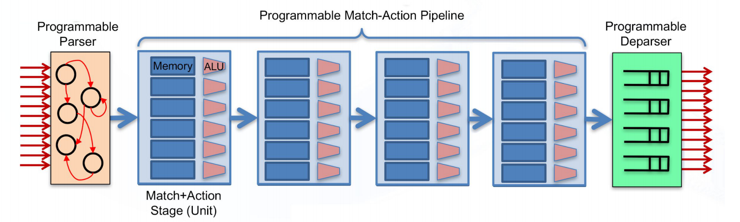
协议无关的交换机架构 PISA
包括可编程的解析器（parser），可重构的流水线（pipeline）和可编程的逆解析器（deparser）三个部分

Slide 75
解析器可以看做是一个有限状态机，将报文头字段按照预先定义的格式和方法层层解封装。解析器是可以编程的，以支持用户自定义的数据包头格式，实现对新网络协议的支持。
流水线由多个流水级组成，每个流水级包含多个可编程的处理单元，可以并行对报文执行操作。
逆解析器重新将报文封装，将修改后的报文头字写回报文。

Slide 76
Benefits
Data plane programming introduces full flexibility to network packet processing,
i.e., algorithms, protocols, features can be added, modified, or removed by the user.
In addition, programmable data planes can be equipped with a user-defined API for control plane programmability and SDN.
To keep complexity low, only components needed for a particular use case might be included in the code. This improves security and efficiency compared to multi-purpose appliances.

Slide 77
User: Allows network equipment designers and even users to experiment with new protocols and design unique applications;
both do no longer depend on vendors of specialized packet-processing ASICs to implement custom algorithms.
Vendor: beneficial for network equipment developers that can easily create differentiated products despite using the same packet processing ASIC.

Slide 78
Programming RMT: P4
RMT provides flexibility, but programming it is akin to x86 assembly
Concurrently, other programmable chips being developed: Intel FlexPipe, Cavium Xpliant, CORSA, …
Portable language to program these chips

Slide 79
P4
P4 作为一种交换机配置的高级语言，它具有三个特性：
（1）可重构性：也就是可以重新配置部署，当交换机被设定好之后，网络开 发人员也可以根据自身需要更改交换机处理数据流的方式，实现定制“现场”的 可重构能力。
（2）协议无关性：交换机的可编程不需要与任何特定的厂商绑定各种网络协 议，而是通过自定义解析流程，设定匹配顺序和编写数据流控制程序实现数据分 组的转发。
（3）目标无关性：开发人员不需要关心底层特定硬件设备的具体实现细节就 可完成对数据包处理过程进行编程的操作，而与交换机事先设置程序设定的目标 无关。

Slide 80
P4 main ideas
Abstractions for
Programmable parser: headers, parsers
Match-action: tables, actions
Chaining match-action tables: control flow
Notes:
Emphasize that this is a first step and things will get better.

Slide 81
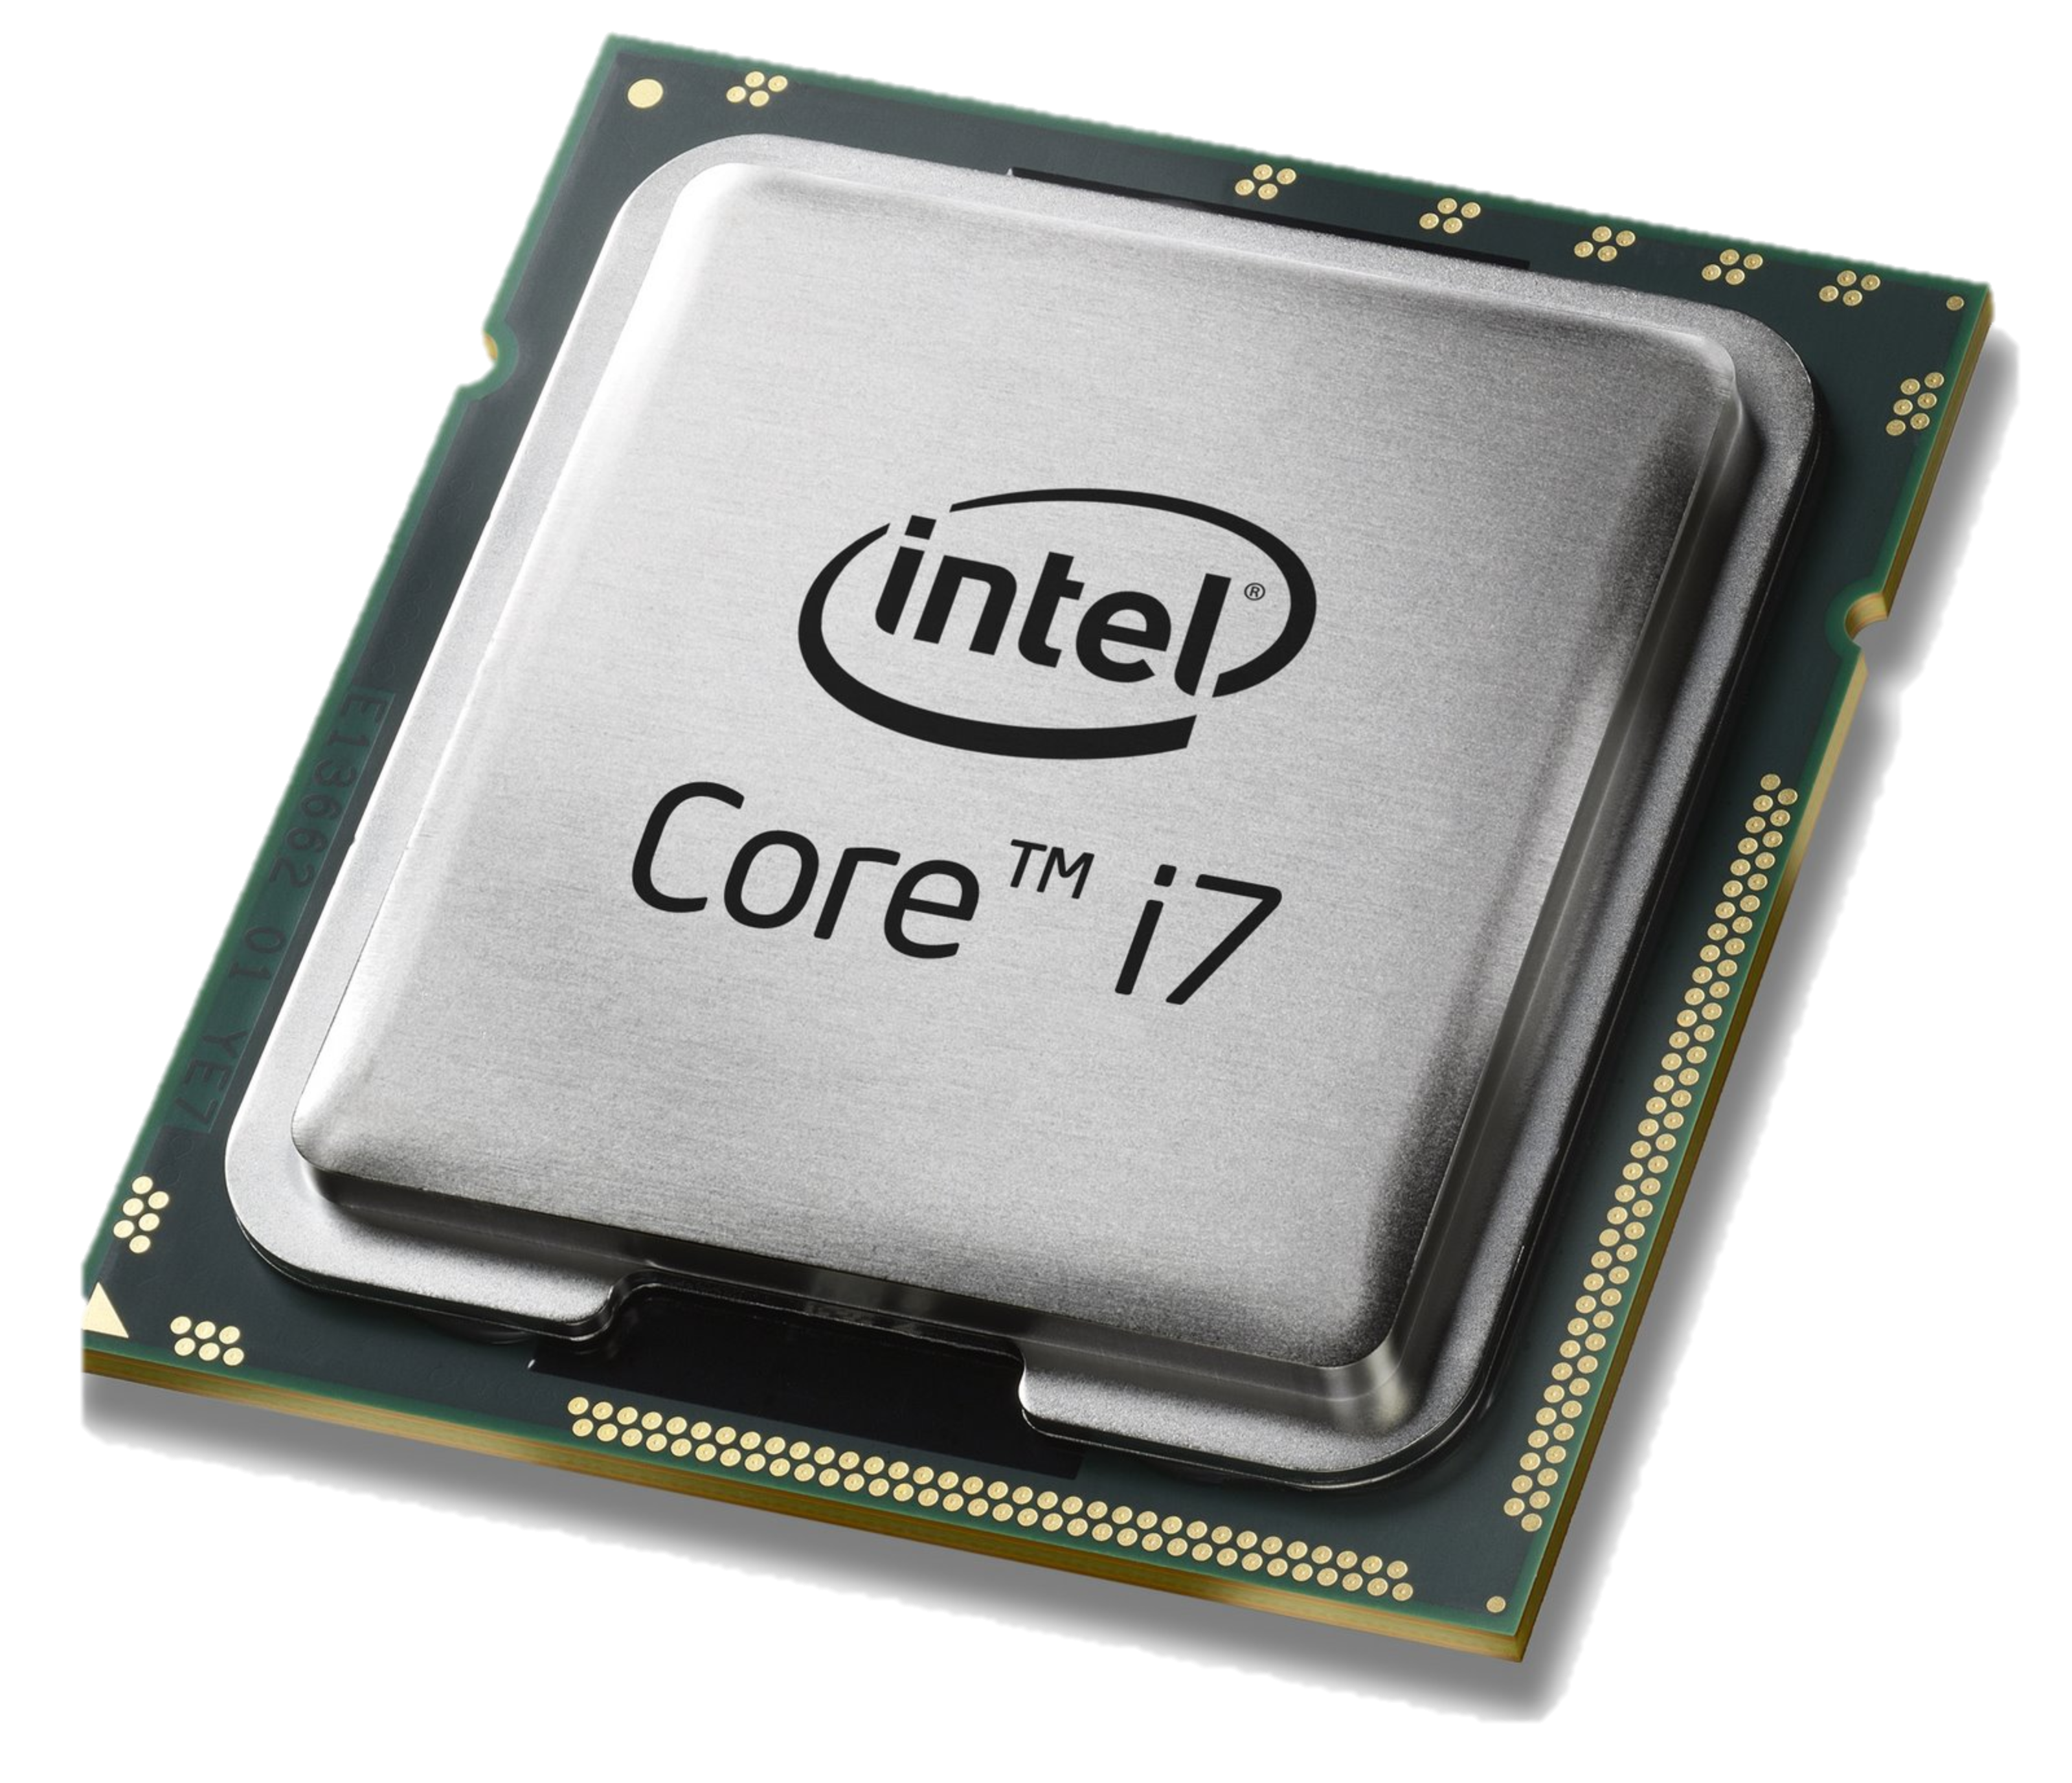
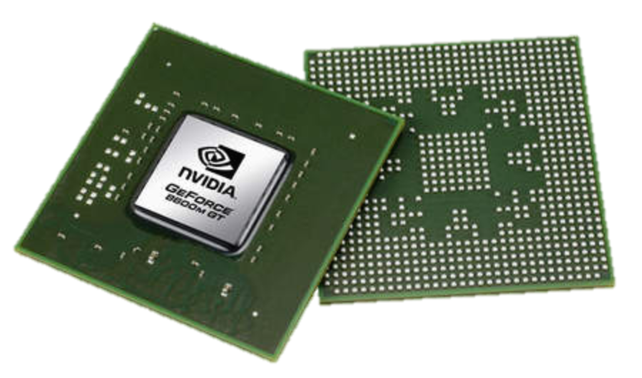
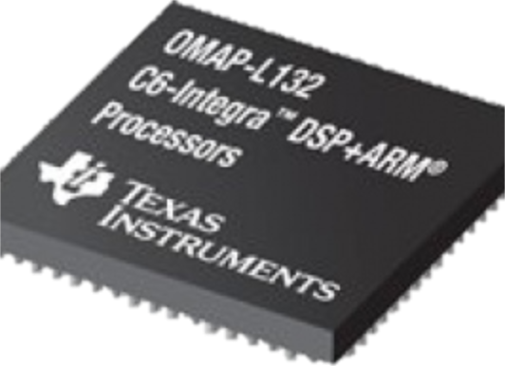
Domain Specific Processors
Signal
Processing
Machine
Learning
Computers
Graphics
Networking
Java
OpenCL
Matlab
TensorFlow
>>>
P4
Compiler
Compiler
Compiler
Compiler
Compiler
?
CPU
GPU
DSP
TPU
PISA

Slide 82
PISA: Protocol Independent Switch Architecture
Match+Action Stage
Memory
ALU
Programmable Parser
Programmable Match-Action Pipeline

Slide 83
PISA: Protocol Independent Switch Architecture

Slide 84
Example P4 Program
Parser Program
Header and Data Declarations
Tables and Control Flow
parser parse_ethernet { extract(ethernet); return switch(ethernet.ethertype) { 0x8100 : parse_vlan_tag; 0x0800 : parse_ipv4; 0x8847 : parse_mpls; default: ingress; }
header_type ethernet_t { … }
header_type l2_metadata_t { … }
header ethernet_t ethernet;
header vlan_tag_t vlan_tag[2];
metadata l2_metadata_t l2_meta;
table port_table { … }
control ingress { apply(port_table); if (l2_meta.vlan_tags == 0) { process_assign_vlan();
} }
Memory
ALU
Programmable Parser
Programmable Match-Action Pipeline

Slide 85
P4 Scope
Control plane
Table mgmt.
Traditional switch
Control traffic
Data plane
Packets
Control plane
P4 Program
P4 table mgmt.
P4-defined switch
Data plane
Notes:
This is the P4 API: a new API between the control-plane and the data plane.
The data plane performs mostly stateless high-speed processing.
The data plane is lean and fast; most of the complexity is still in the control plane. P4 does not address this aspect.

Slide 86
Q: Which data plane? A: Any data plane!
Programmable switches
FPGA switches
Programmable NICs
Software switches
Control plane
Data plane
Notes:
P4 should be portable across a large spectrum of switch implementations.

Slide 87
Reflections on a programmable switch
Why care about programmability?
If you knew exactly what your switch had to do, you would build it.
But, the only constant is change.
(Hopefully) no more lengthy standard meetings for a new protocol.
Move beyond thinking about features to instructions.
Eliminate hardware bugs, everything is now software/firmware.

Slide 88
Thank You.
Slides courtesy of
Patrick Bosshart, Nick McKeown, and Mihai Budiu, P4 Tutorial
Yashar Ganjali, CSC 2229 Course
Jennifer Rexford, COS 561 Course
James Won-Ki Hong, SDN course

